Slide 1

Adventure Works – Sales Analytics Project
Group – 4
Abhishek,
Chemikalal
Febby
Prshanth
Vardhan
Pragati
Sweety

Slide 2


Project Summary: Driving Data by using below software
SQL: For extracting, cleaning, and transforming data from relational databases.
Excel: For data modelling, advanced calculations, and ad-hoc analysis using PivotTables and formulas.
Tableau: For interactive dashboards and storytelling with data to uncover trends and outliers.
Power BI: For building real-time dashboards, business metrics tracking, and sharing insights across teams.

Slide 3
Year and Month-Wise Sales Performance
Year Wise Sales performance
This chart shows total sales generated in each year from 2010 to 2013.
Sales growth increased with a negligible amount from 2010 to over 16 million in 2013. The jump from 2012 to 2013 alone was 84% growth.
Month Wise Sales performance
Monthly sales show a gradual upward slope with fluctuations.
Sales dip slightly mid-year (July) but quickly recover.
Seasonality Insight:
A clear spike in Q4, particularly in December, suggesting a holiday or seasonal sales effect.

Slide 4
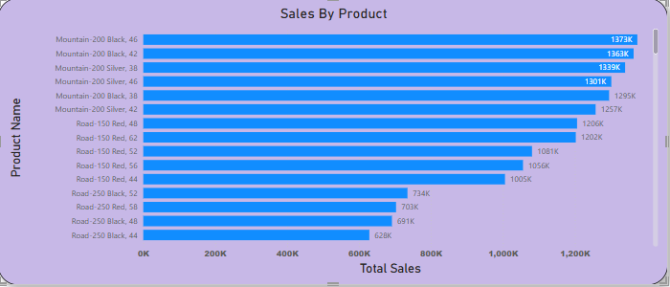
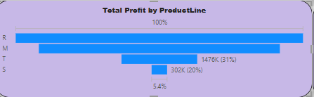
Total Sales by Model Name and Product Name
Total Sales by Productline
The Above chart is Horizontal Bars: Represent the total profit for each product line.
The Product Line R represent the highest profit, Product Line M and T represent slightly shorter than R and Product Line S represent the smallest profit contributor
As shown in the chart the Product Line S contributes the least and may require further analysis (e.g., low sales, high costs, or poor market fit).
The percentage and value labelling for T and S are useful for quick, data-driven insights.
Total Sales by Product Name
Reinforces the previous chart – product variant performance is highly skewed.
Top Products:
Mountain-200 Black, 46 — 137K
Mountain-200 Silver, 42 — 136K
Mountain-200 Silver, 38 — 132K
Ratio of total sales by Product :-
Above three products make up about 21% of all 60K orders.

Slide 5
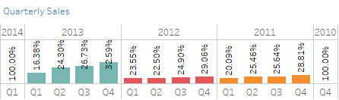
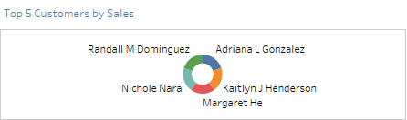
Quarterly wise sales with Top 5 customers Performance
Quarter wise sales
This is a stacked vertical bar chart, with each bar representing annual total sales (100%) broken down by quarter.
Each colour within a bar represents the contribution of that quarter (Q1 to Q4) to the total sales in that year.
The sales distribution is fairly balanced in years like 2012 and 2011 but more skewed in 2013 and 2014.
Top 5 customers by Sales
Donut Chart: This is a circular chart with a hole in the middle, used to show proportions of categories (in this case, customers).
The names of the top 5 customers are placed around the chart, corresponding to the coloured segments.
The size of each coloured segment represents the relative amount of sales attributed to that customer. Larger segments mean higher sales contribution. From a design standpoint, this chart provides a quick and visual way to identify who the top-performing customers are in terms of sales.

Slide 6
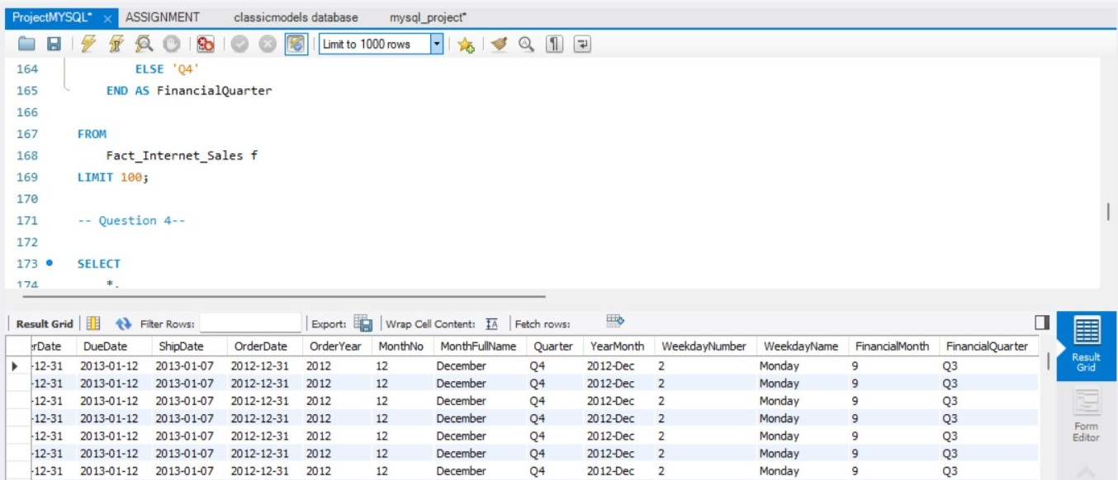
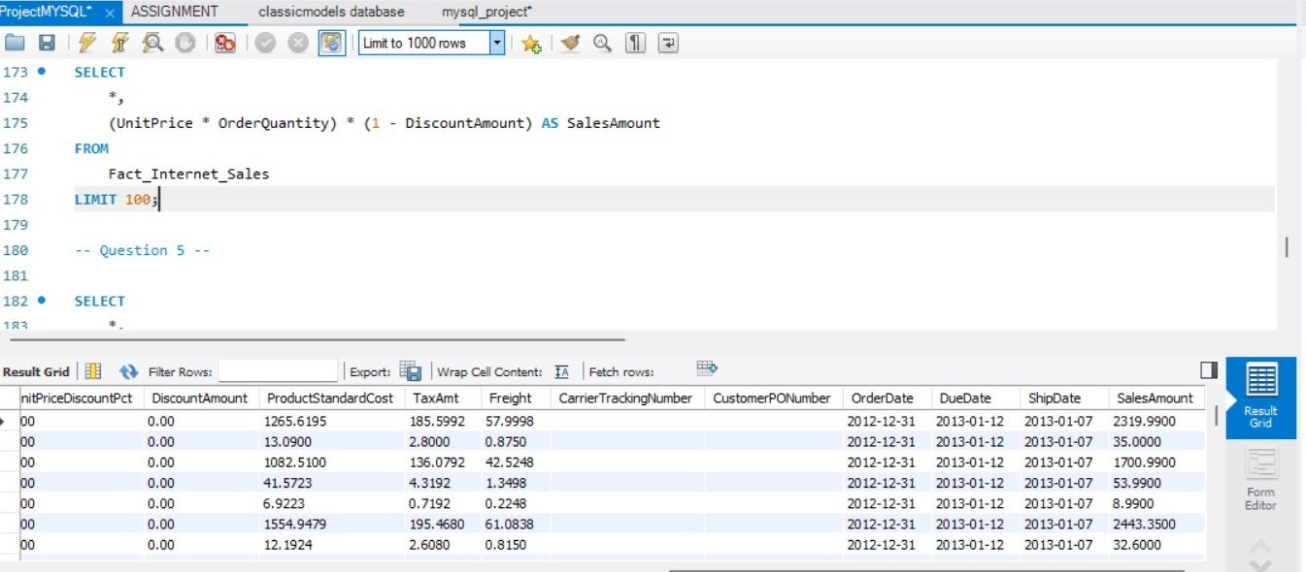
SQL QUERIES OVERVIEW and there uses
Align reports with a company's fiscal year (e.g., Q1 may start in July).
Analyse sales by day of week (e.g., Monday trends).
Group data into time periods for comparisons (monthly, quarterly).
Track revenue performance.
Create sales reports with accurate post-discount values.
Analyse profitability when paired with cost data (ProductStandardCost).
Compare gross vs net sales.

Slide 7
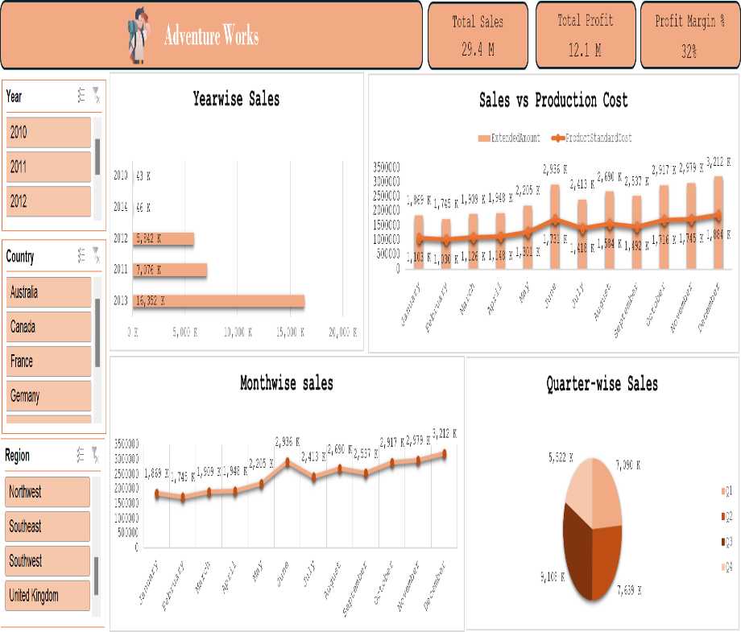
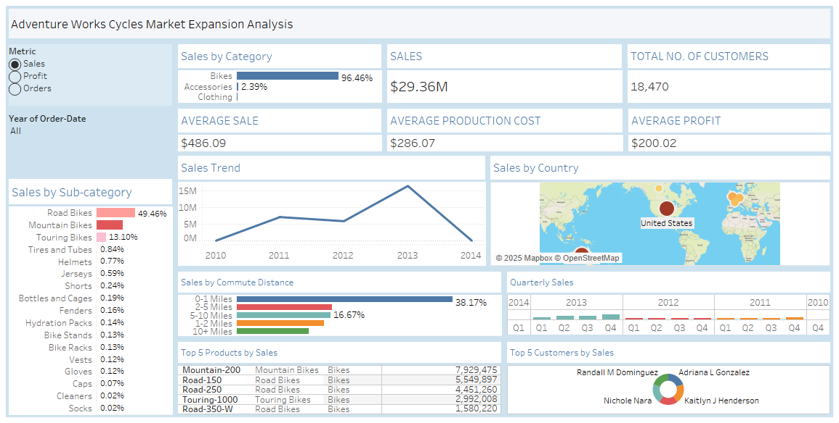
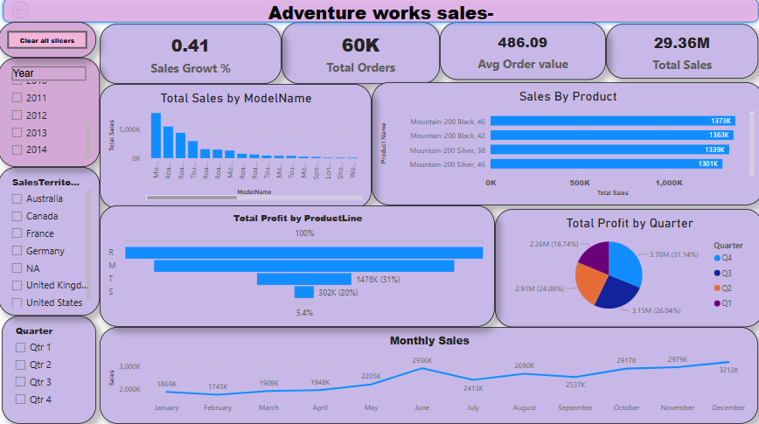
DASHBOARD
EXCEL
TABLEAU
PowerBI

Slide 8


